Slide 1
Realtime Motion Detection with cuda
EE5351 By Sanjit Dash, AnuBHAV PANDA

Slide 2
OVERVIEW
Objective
Implementation
Architecture
Parallel Implementation
Serial Implementation
Results
Speed Up
Analysis
Challenges and Improvements
References

Slide 3
Objective
Goal : Utilize the ability of GPU to accelerate computer vision algorithms like Motion Detection
Motion Detection is a widely used computer vision application.
Some of the major application areas are :
Surveillance
Pattern recognition such as pedestrian detection, vehicle detection
Analysis of the captured motion data (eg: helping athletes to improve their performance,Real time traffic Ananlysis)

Slide 4
Architecture
Video file/Cam Feed
Gaussian Blur
Edge Detection
Selective Thresholding
Difference Filter
RGB
Grayscale
Frames
Motion Detection
Erosion Filter

Slide 5
Reading Video
OpenCV 2.4.5(Linux) / 3.4.1(Windows)
Linux Limitations
FFMPEG – not installed
Gstreamer to read sequence of images
Reading Frames from video using OpenCV
Converting to grayscale for further processing

Slide 6
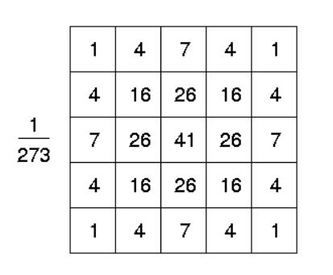
Noise Reduction
Gaussian filter(Low Pass filter) is used to reduce high frequency noise from the image.
This is the filter used.
Convolution is used to apply the mask on the image.

Slide 7
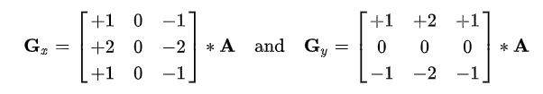

Edge Detection
Sobel Filter is used to approximate the gradient of the image.
Gradient’s magnitude and angle at each pixel is computed.
$G= \sqrt{{Gx}^{2}+{Gy}^{2}} , θ=\tan^{−1}{\frac{Gy}{Gx}}$
Convolution is used to calculate Gx and Gy.
Edges correspond to the pixels with high gradient magnitude.

Slide 8
Selective Thresholding
Pixels with gradient magnitude below a user defined threshold are suppressed. (Non Maximum Suppression)
Pixels with magnitude above the threshold and also above those pixels in the gradient direction are enhanced.
Selective thresholding is applied to a mask around each selected pixel to catch the pixels that might have been missed to create continuous edges.

Slide 9

Difference Map
Edges of two consecutive frames are detected and their difference is checked to detect motion.
Large difference between frames indicate motion.
$D=\left|E1 −E2\right|==0?0:255$
This process is continuously repeated for every pair of frames in order to detect a real time motion.

Slide 10
Motion Detection
Erosion Filter is applied to remove the noise from difference output.
For each pixel of difference with a value of 255, rectangle is drawn on the original frame to show motion.
For erosion and rectangle OpenCV inbuilt functions are used.

Slide 11
Kernels Used FOR PARALLEL IMPLEMENTATION
Convolution for Gaussian
Convolution for Sobel x
Convolution for Sobel y
Calculation of Gradient magnitude and angle
Thresholding and Suppression
Difference
Total 11 kernel calls for 2 frames. 5 for frame 1, 5 for frame 2 and difference.

Slide 12
Techniques Implemented
Convolution with shared memory
Constant Memory for filter(mask)
Shared memory for thresholding with respect to neighbors.
Pinned memory to avoid shadow copy.
Streams to parallelize kernel calls for two consecutive frames.
Maximum thread utilized.
Thread Coarsening

Slide 13
Sequential Version
cv::GaussianBlur(source, blurred, cv::Size(5, 5), 0);
cv::Sobel(blurred, grad_x, CV_8U, 1, 0, 3, scale, delta, cv::BORDER_DEFAULT);
cv::convertScaleAbs(grad_x, abs_grad_x);
cv::Sobel(blurred, grad_y, CV_8U, 0, 1, 3, scale, delta, cv::BORDER_DEFAULT);
cv::convertScaleAbs(grad_y, abs_grad_y);
addWeighted to compute the gradient values
serial_thresholding_and_suppression
serial_difference_filter
cv::erode(difference_img, difference_img, elementErode);
cv::rectangle(motionFrame, cv::Point(j - 5, i - 5), cv::Point(j + 5, i + 5), cv::Scalar(255, 0, 0), 1);

Slide 14
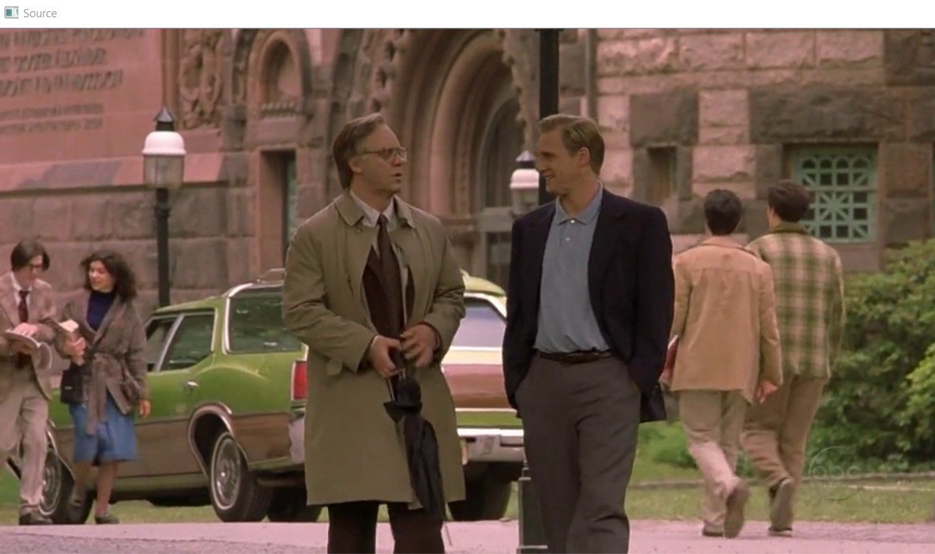
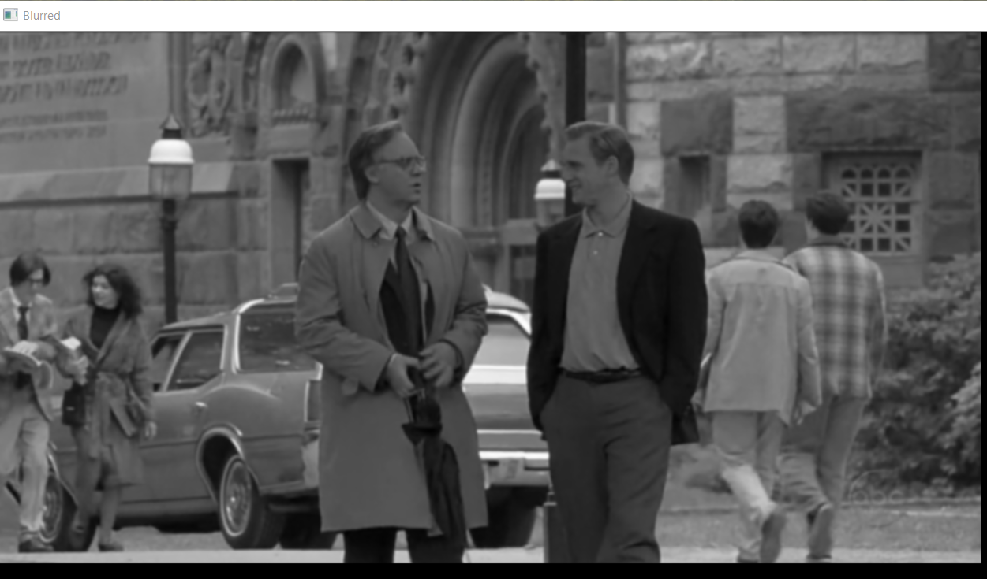
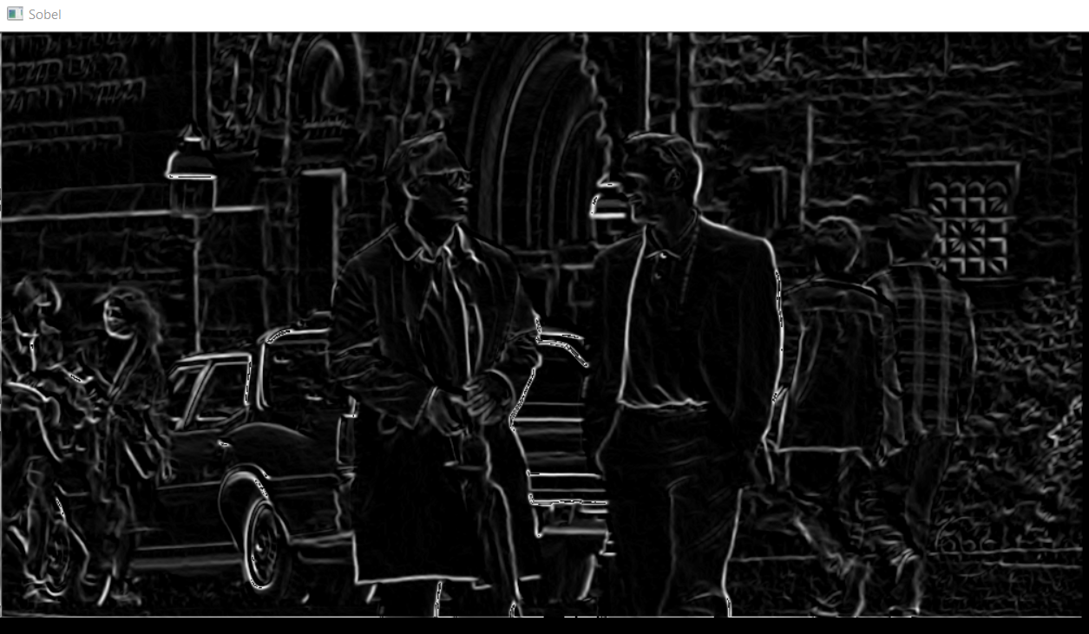
Results
Source
Gaussian
Sobel

Slide 15
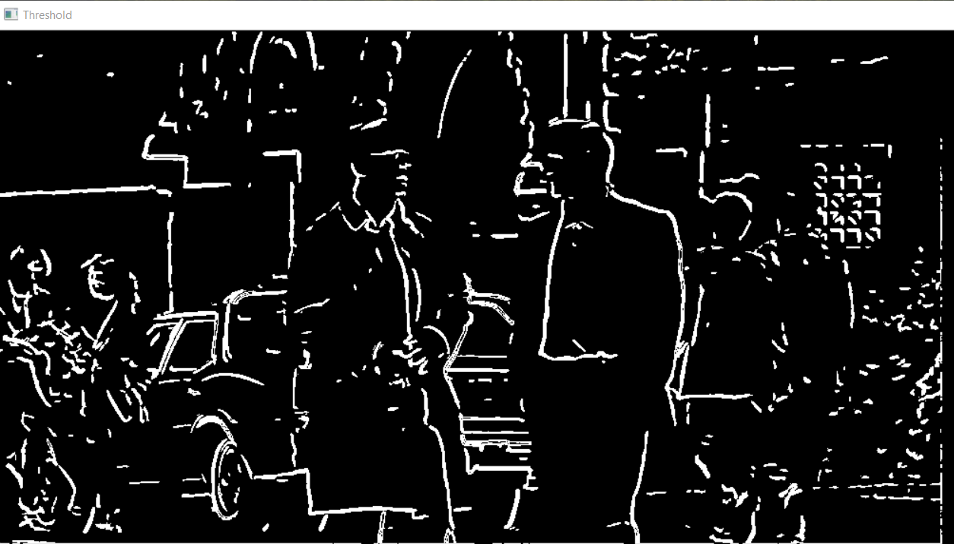
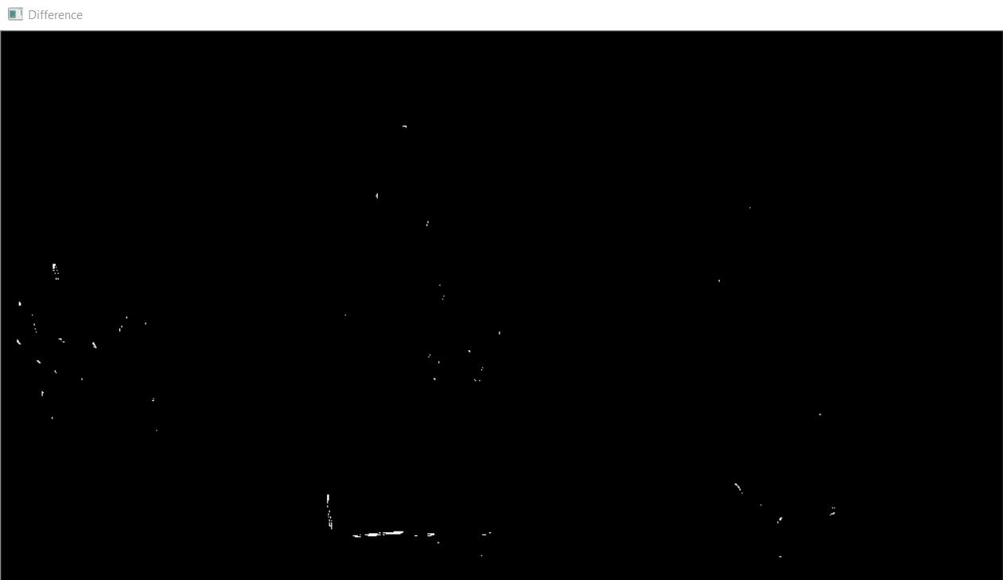
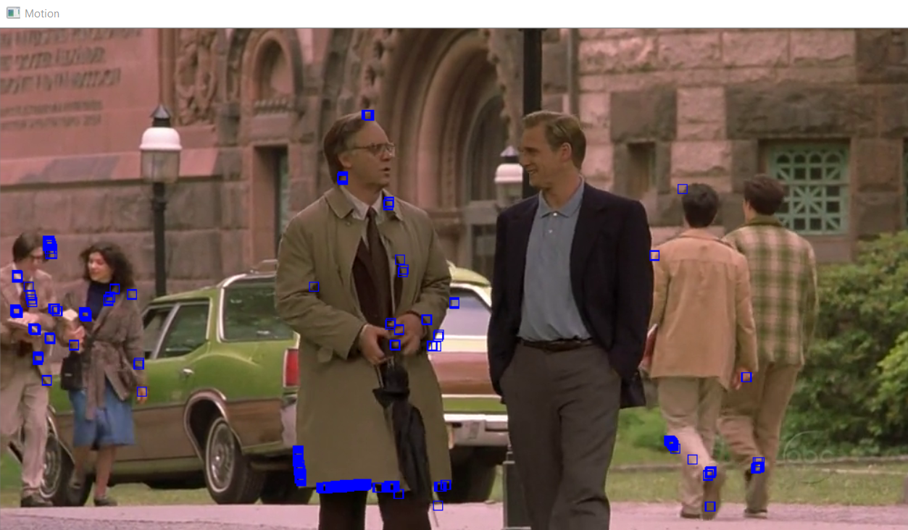
ReSults
Threshold
Difference
Motion Detection

Slide 16
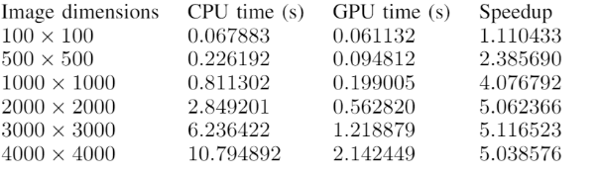
Speed UP
Speed up depends on the size and quality of the input
We are gaining around 5x-10X speed up based upon the quality of the input
Expected result(According to the reference paper)

Slide 17
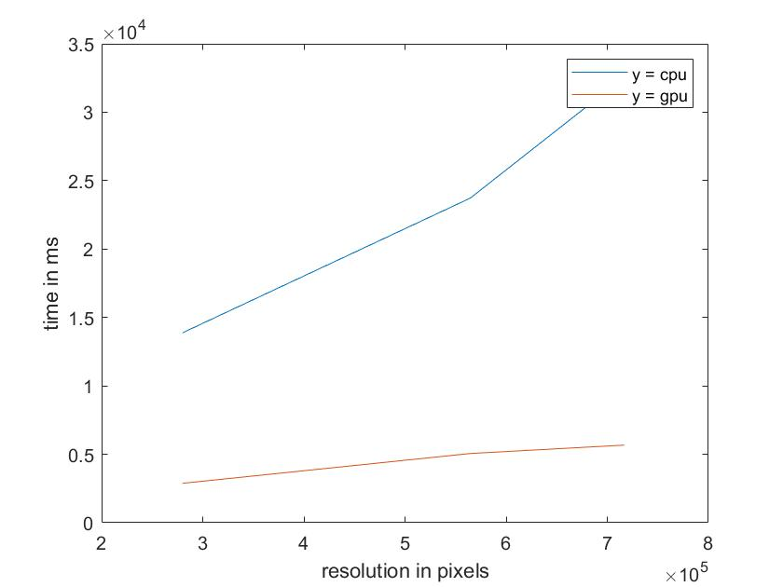
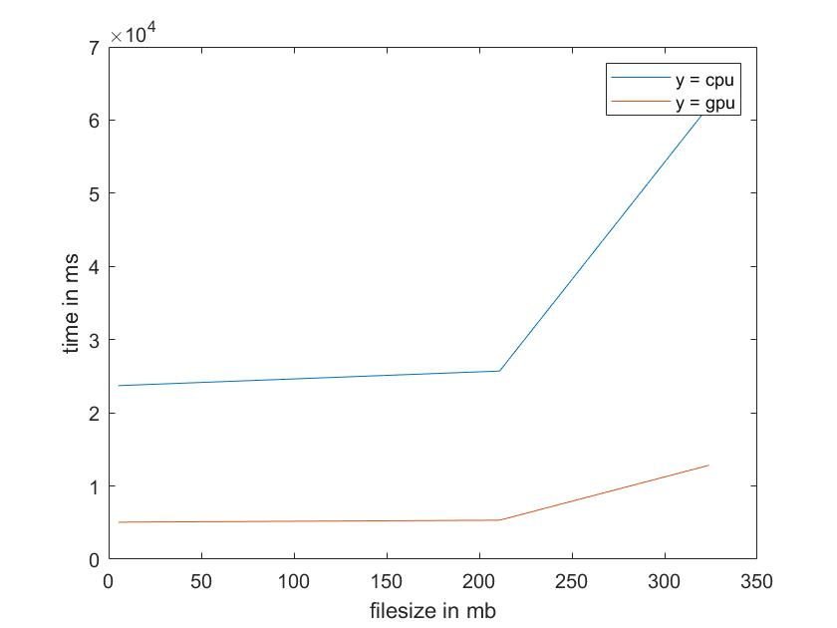
Analysis

Slide 18
Challenges And Improvements
Linux Systems does not have ffmpeg.(converted the video into sequence of images) and processed it for performance calculations.
Device computation is compute bound
Erosion filter can be implemented parallelly
Rectangle functions can be implemented parallelly
We can transfer the data using GMAC For largesize videos

Slide 19
Reference
kl38.web.rice.edu/cuda-computer-vision.pdf
https://ieeexplore.ieee.org/document/8075658/
https://www.vision.ee.ethz.ch/publications/papers/proceedings/eth_biwi_01126.pdf
https://www.codeproject.com/Articles/10248/Motion-Detection-Algorithms

Slide 20
Thank You

